Slide 1
A Two DoF Self Adaptive Bionic Ankle
Shanghai High School International Division
Justin Guo

Slide 2
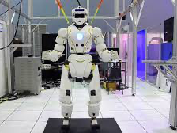
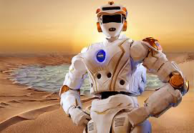
Background Signficance and Proposal
For a human robot, any part of the system needs careful consideration. For robots that focuses more on movement ability, including needing the ability to move through rough terrain and great vertical distance. These robots may take the role to traverse through mountain area, rescue people in a building, or going on a mission to Mars. Using humanoid robots on Mars gives it unchallenged flexibility on exploring and traversing the landscape on Mars.
Proposal: A good leg, or more specific, a good ankle will help the robots to traverse better in complex environments.
Which will include:
an additional motor to control not only the leg's dorsiflexion and plantar flexion, but also inversion and eversion movement of an ankle.
a self adaptive program for it to aid walking using the combination of IMU and laser distance sensors.
the usage of strings and motor to simulate the muscles in human leg
the usage of springs to simulate the shock absorption mechanics in human leg

Slide 3
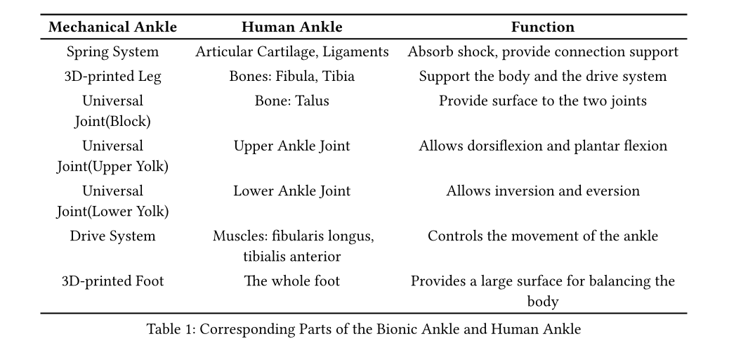
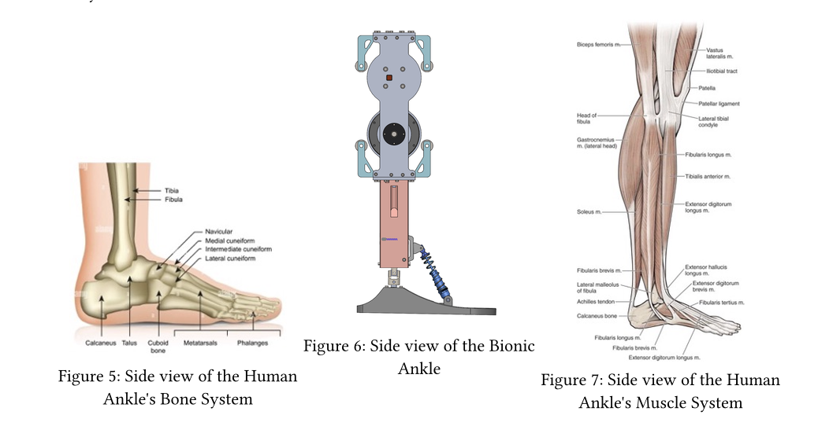
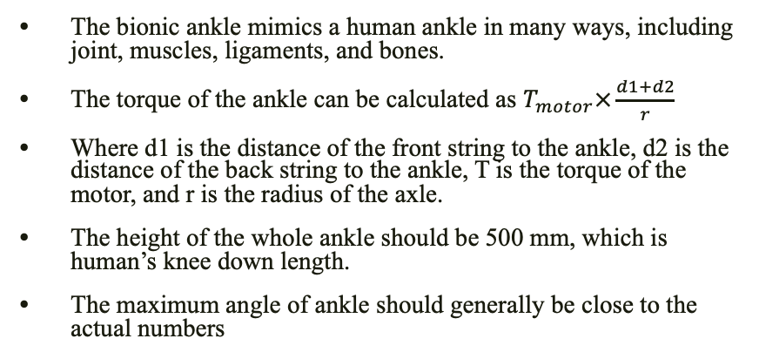
Theoretical Design
The bionic ankle mimics a human ankle in many ways, including joint, muscles, ligaments, and bones.
The torque of the ankle can be calculated as $T_{motor}×\frac{d1+d2}{r}$
Where d1 is the distance of the front string to the ankle, d2 is the distance of the back string to the ankle, T is the torque of the motor, and r is the radius of the axle.
The height of the whole ankle should be 500 mm, which is human’s knee down length.
The maximum angle of ankle should generally be close to the actual numbers

Slide 4
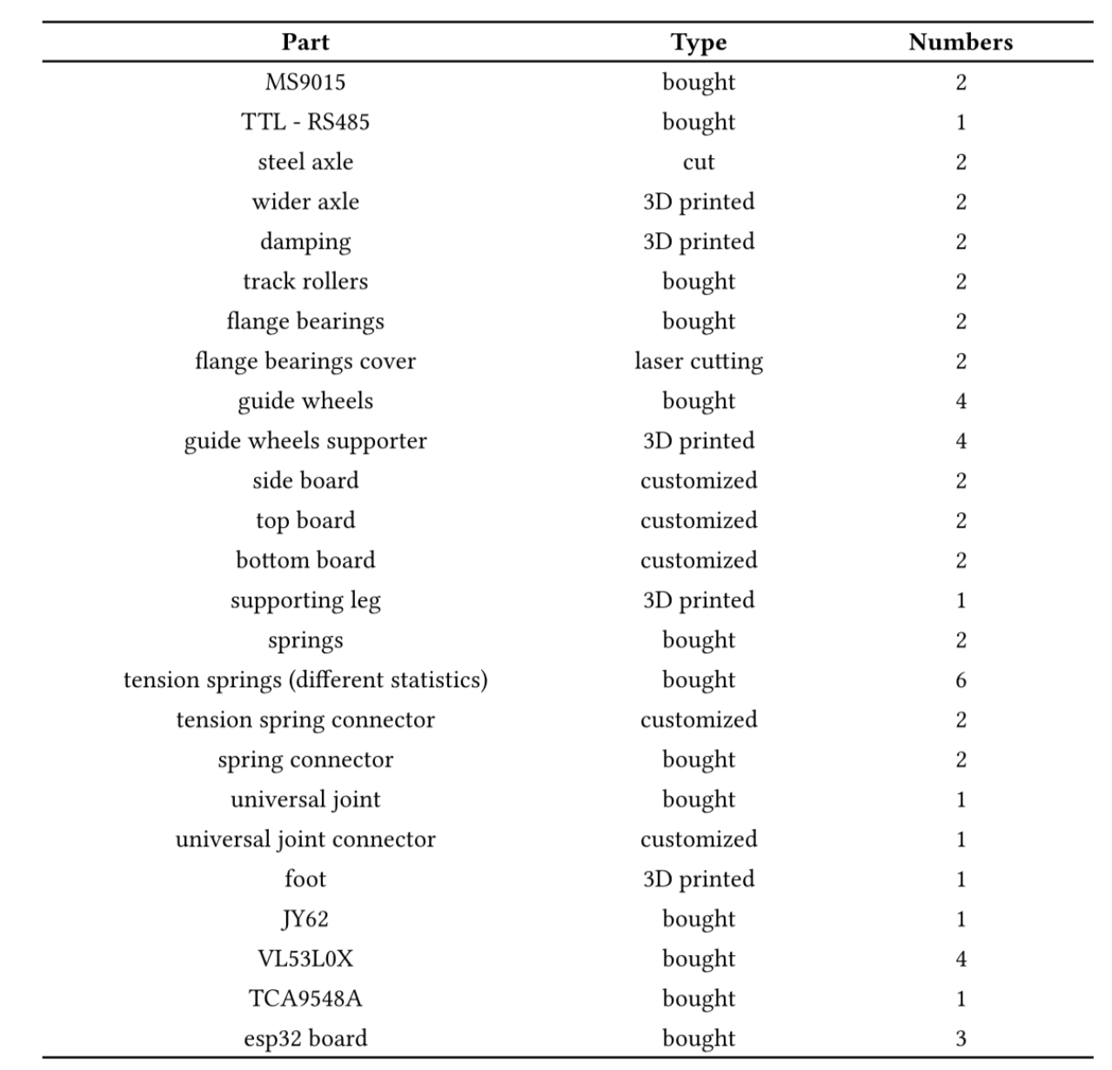
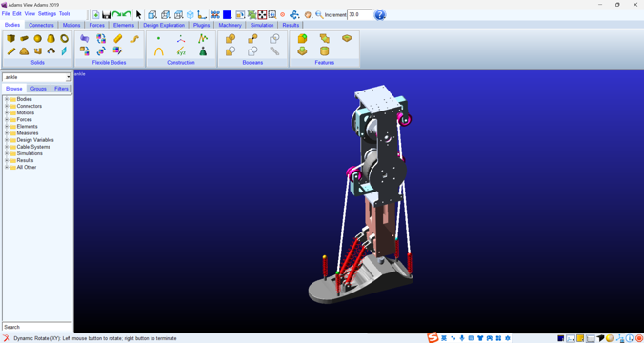
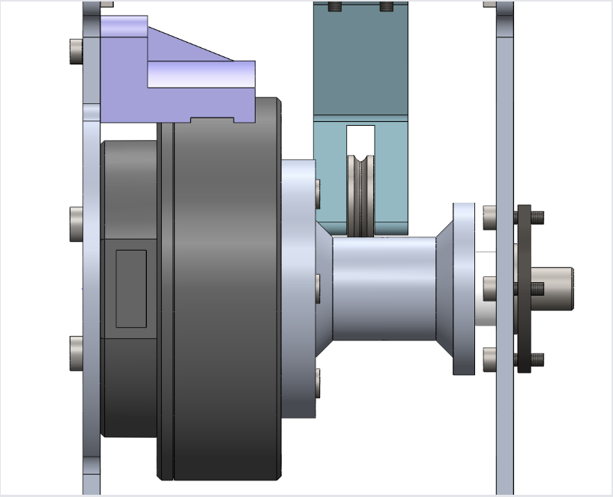
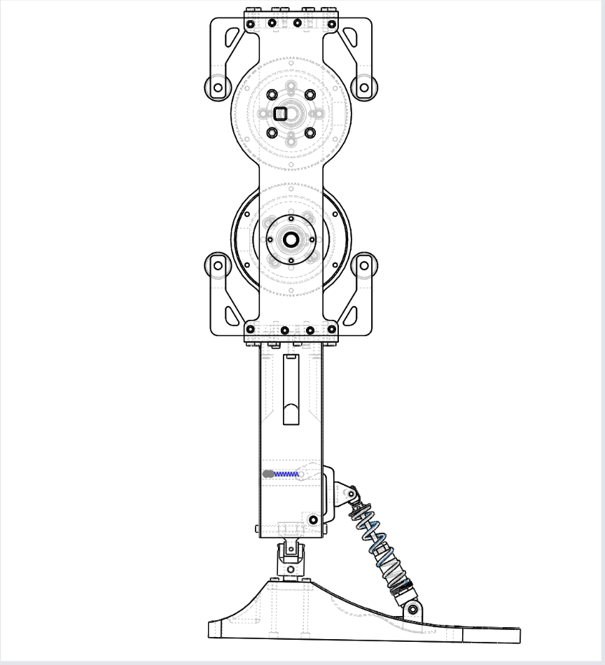
Structural Design
Use Solidworks to plan out the whole structure and record the parts needed to build the whole structure.
The whole leg’s proportions close to human statistics. (The height of the bionic ankle is 500mm).

Slide 5
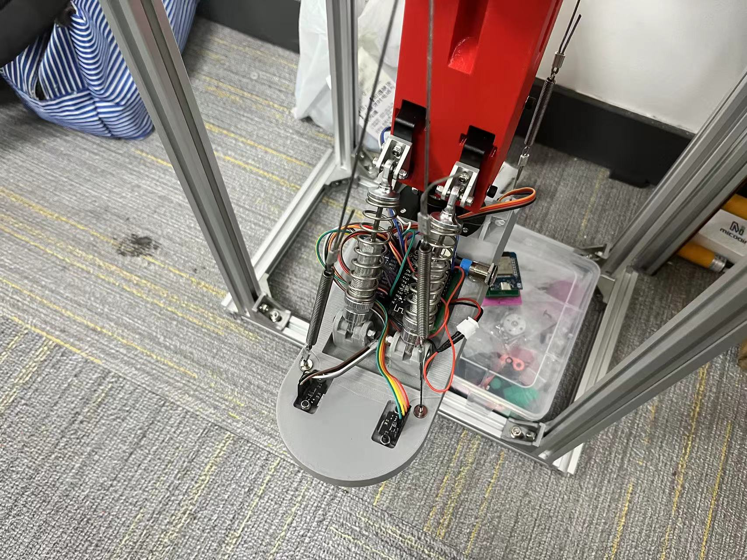
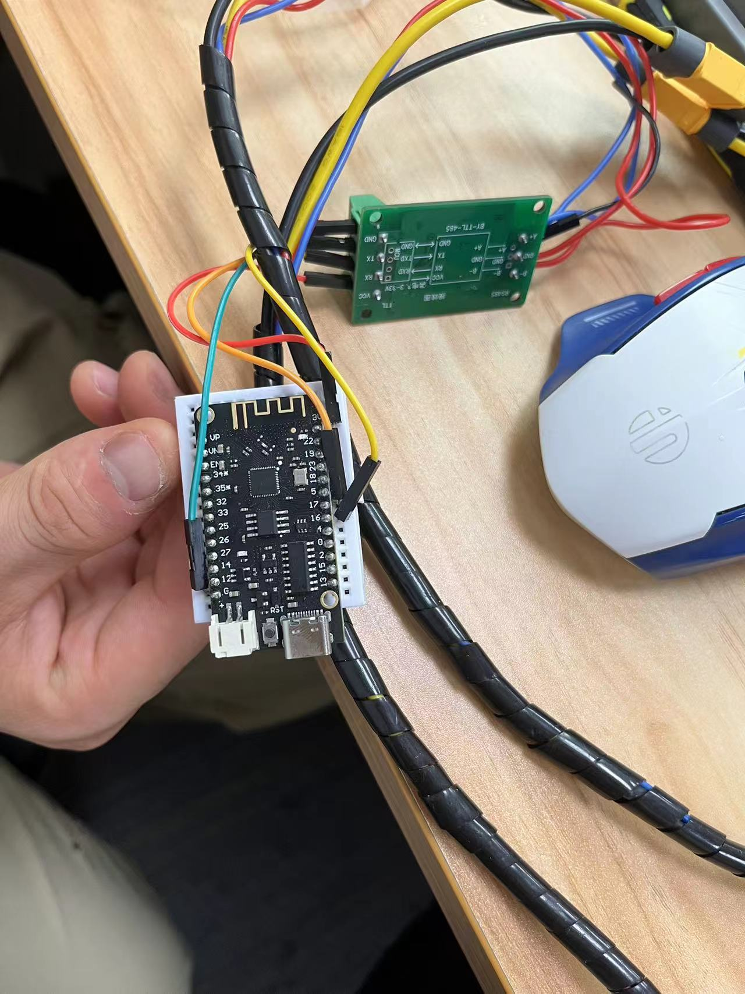
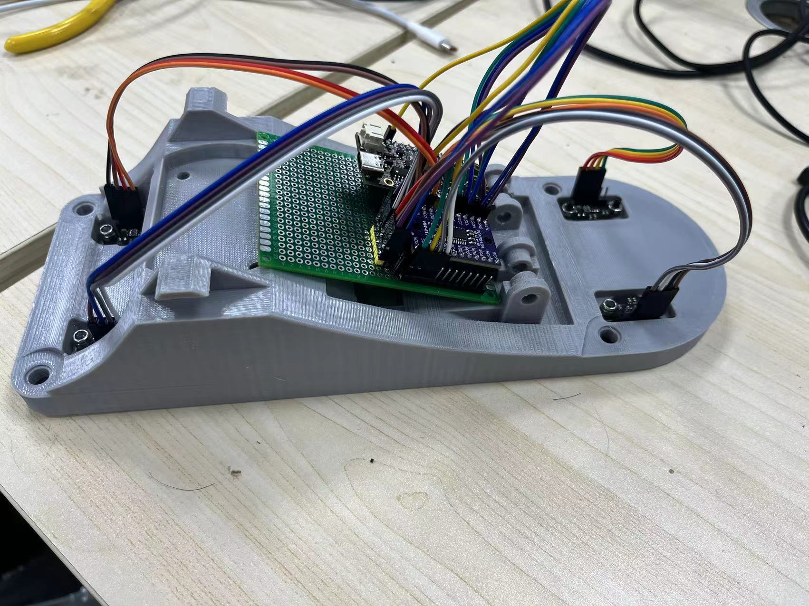
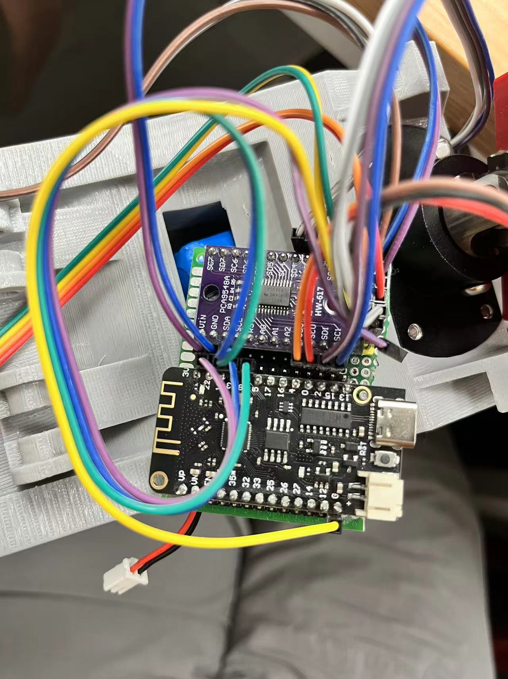
Hardware Design
For IMU, distance sensor, and motors, I choose the most accurate one to use.
I connected the components using wires, and the esp32’s wireless connection.
Also, through calculating the statistics of the motor, and the springs, I choose the ones that best fit the need of a bionic ankle.

Slide 6
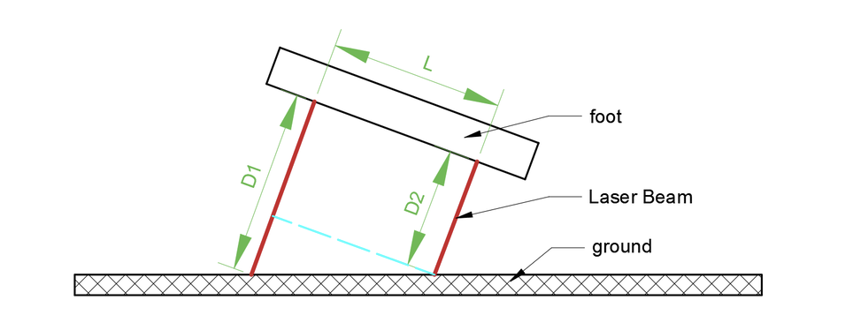
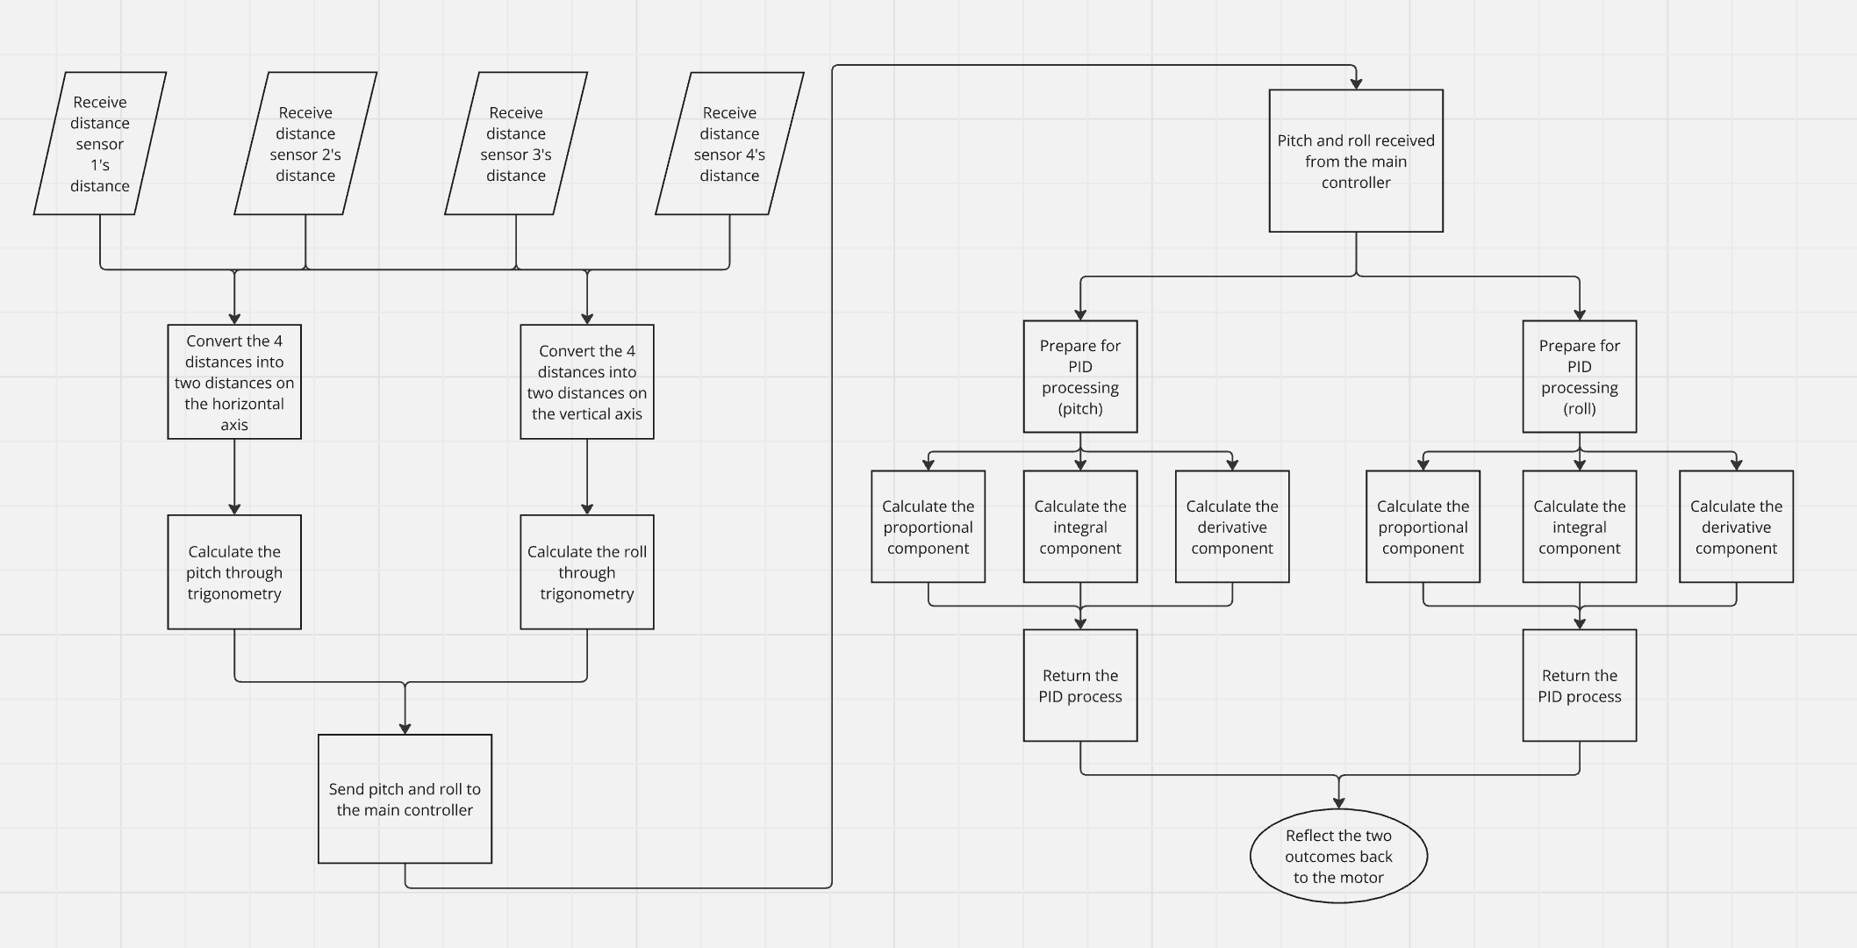
Software Programming
To control the foot, making it parallel to the ground, the angle between the foot and ground is calculated using distance sensors
Next, the PID controller will self-adjust the two angles, roll and pitch, using the three components, proportional, integral, and derivative, to quickly and efficiently adjust the angle of the foot, making it parallel to the ground.

Slide 7
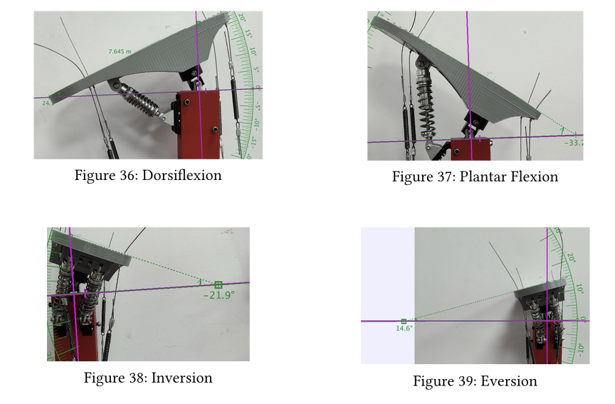
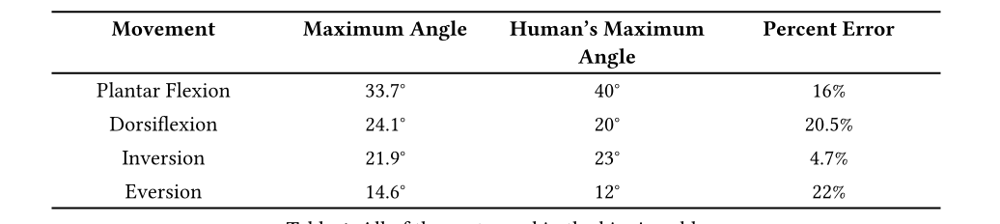
Maximum Angle Experiment
I use my hands to turn the motor such that the foot is in the extreme position. Even if the foot can still move further, it is unnecessary because the strings are too strained to be stable and safe.
I take a picture of the lower part of the foot with the bottom face of the supporting leg perpendicular to the photo frame, and the bottom face of the foot perpendicular to the photo frame.
I use Tracker to analyze the photo:
Take the bottom of the supporting leg as the x-axis, since it is perpendicular to the photo frame, the bottom of the supporting leg is represented by a line.
Use the bottom of the foot as the other ray that locks the angle with the x-axis. The intersection between the line formed by the bottom of the foot and x-axis is the center of the protractor.

Slide 8
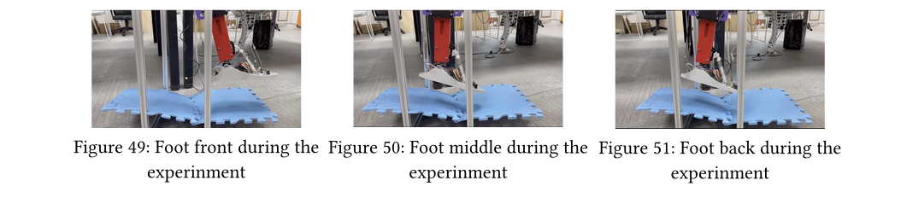
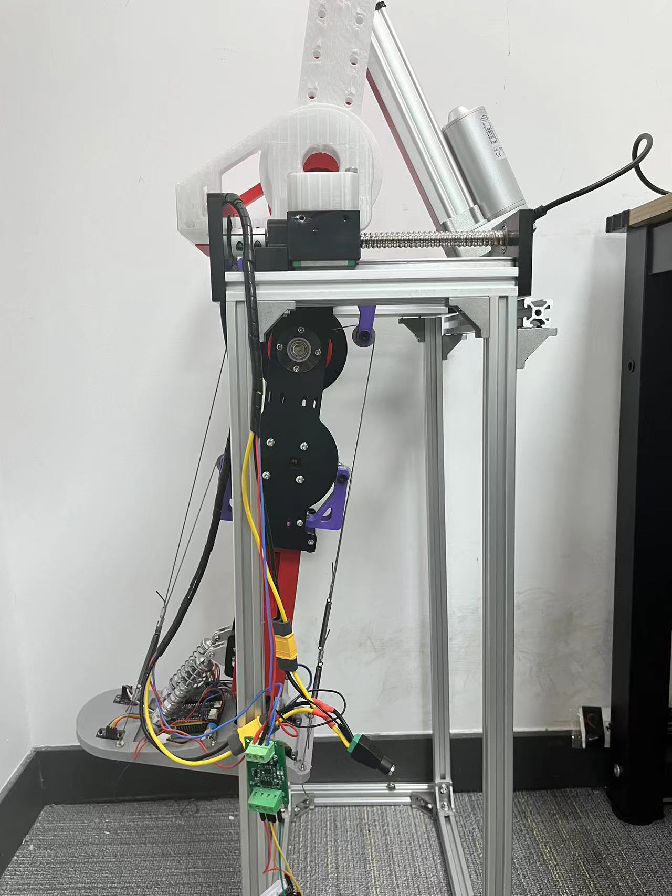
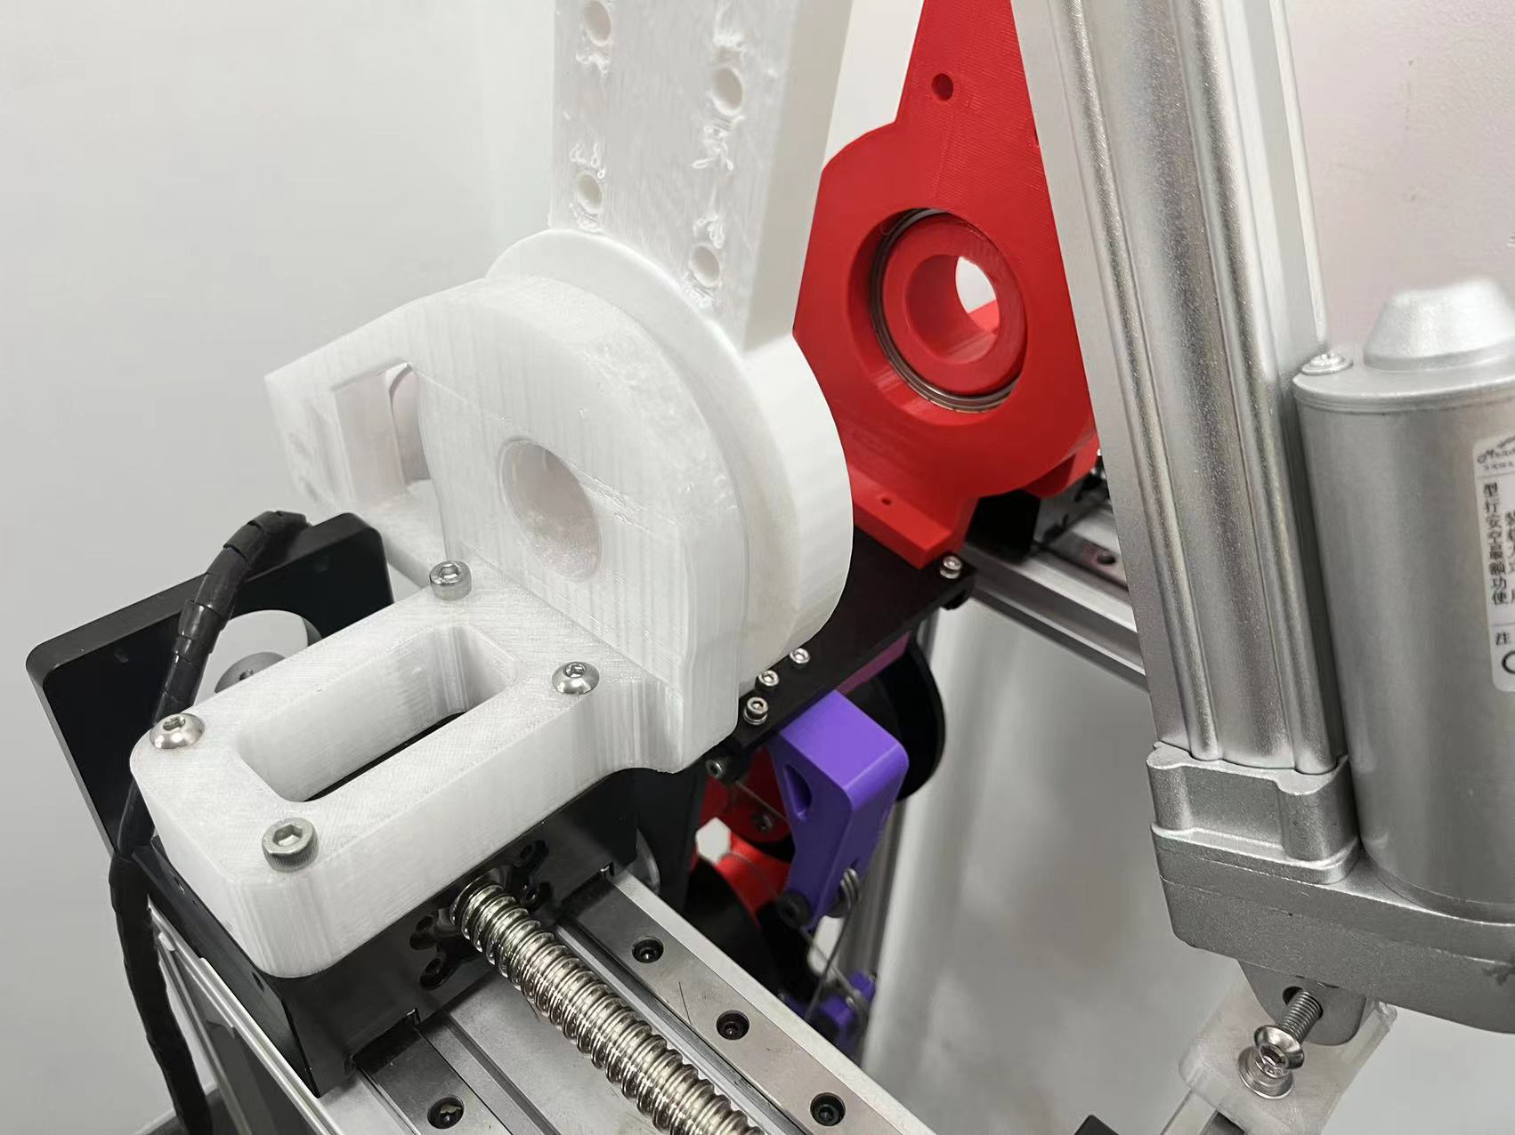
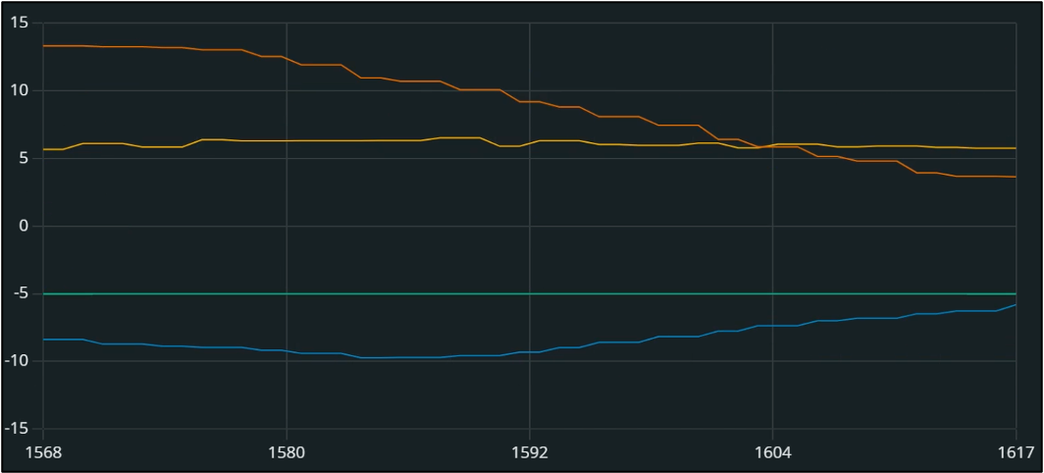
Self Adaptive Experinment
To test the capability of the foot, I build a frame to hang the bionic ankle and oscillating it back and forth using a putter.
As shown below, the foot can adapt to uneven ground.
The Graph displays the enclosing of the foot’s pitch and roll to the ground’s pitch and roll. The time is in milliseconds, which is very fast.

Slide 9
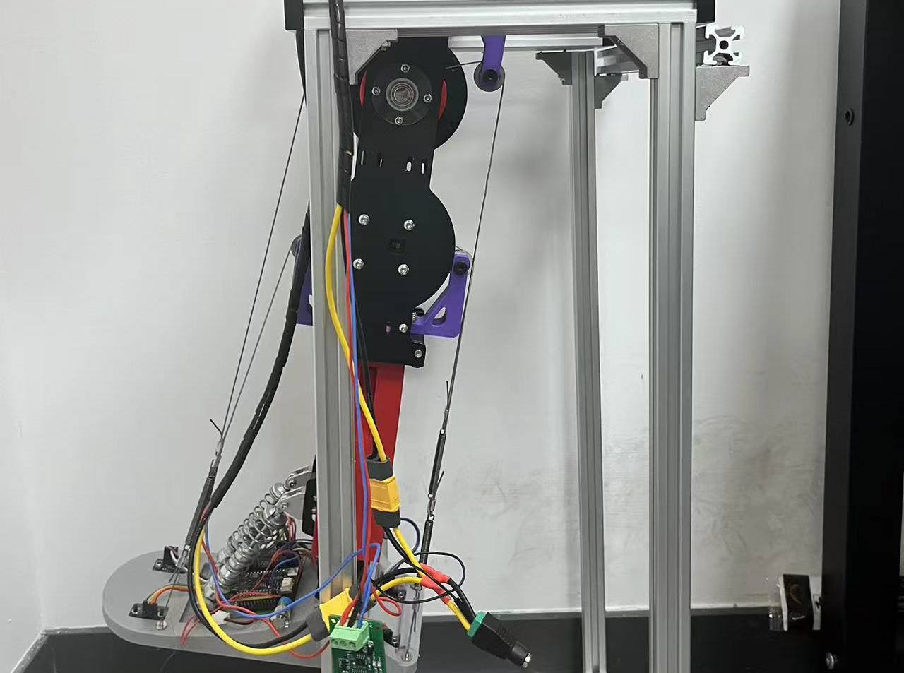
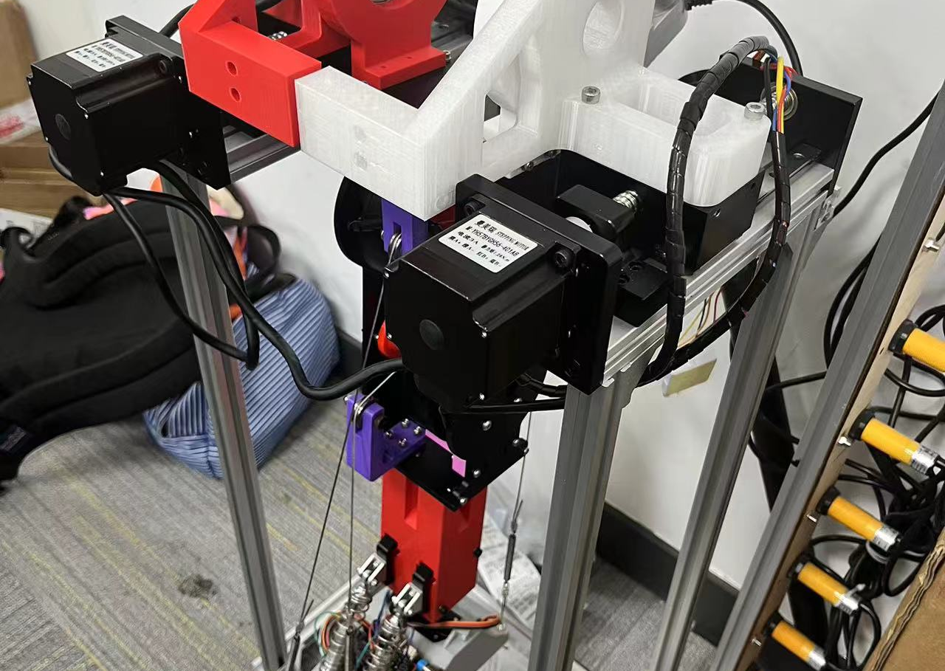
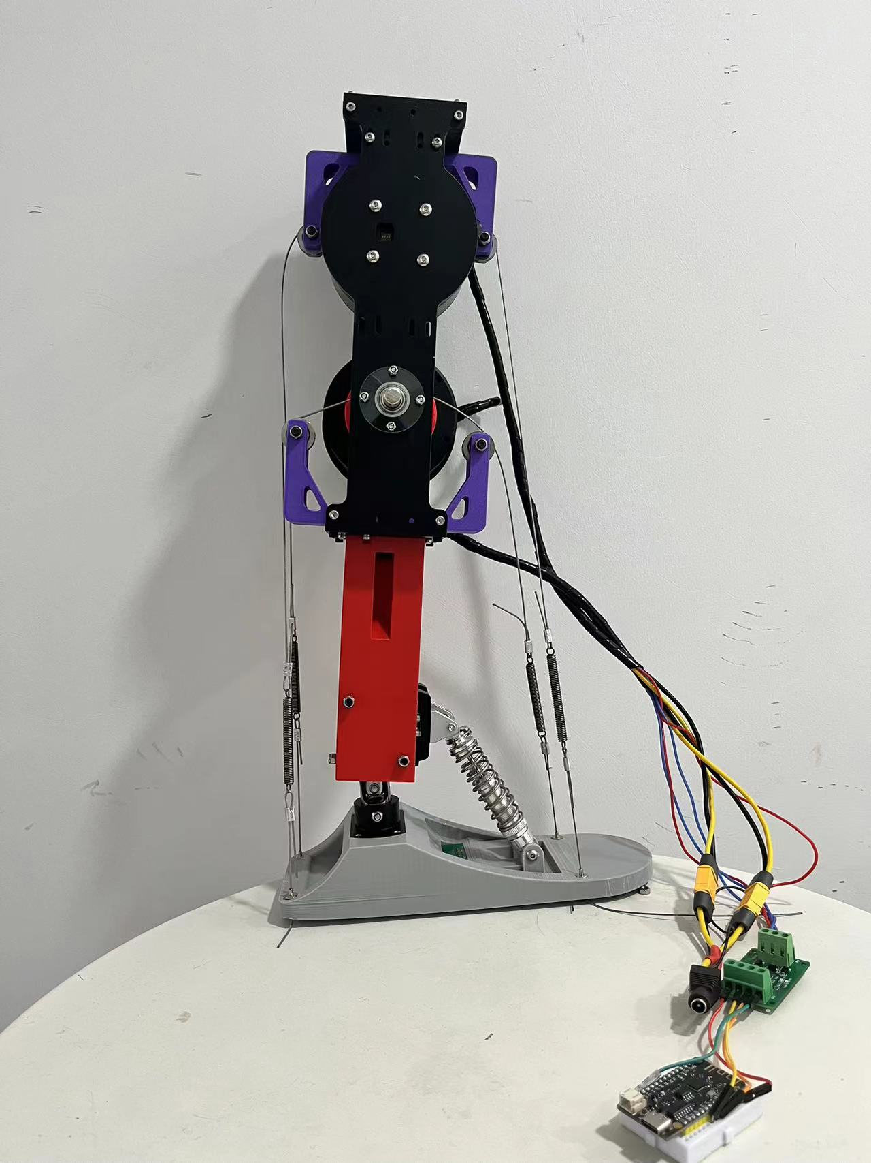
Conclusion
This bionic ankle has a 2 DoF, and a self-adpative program to help it transverse through complex environments which search and rescue robots will benefit from.

Slide 10
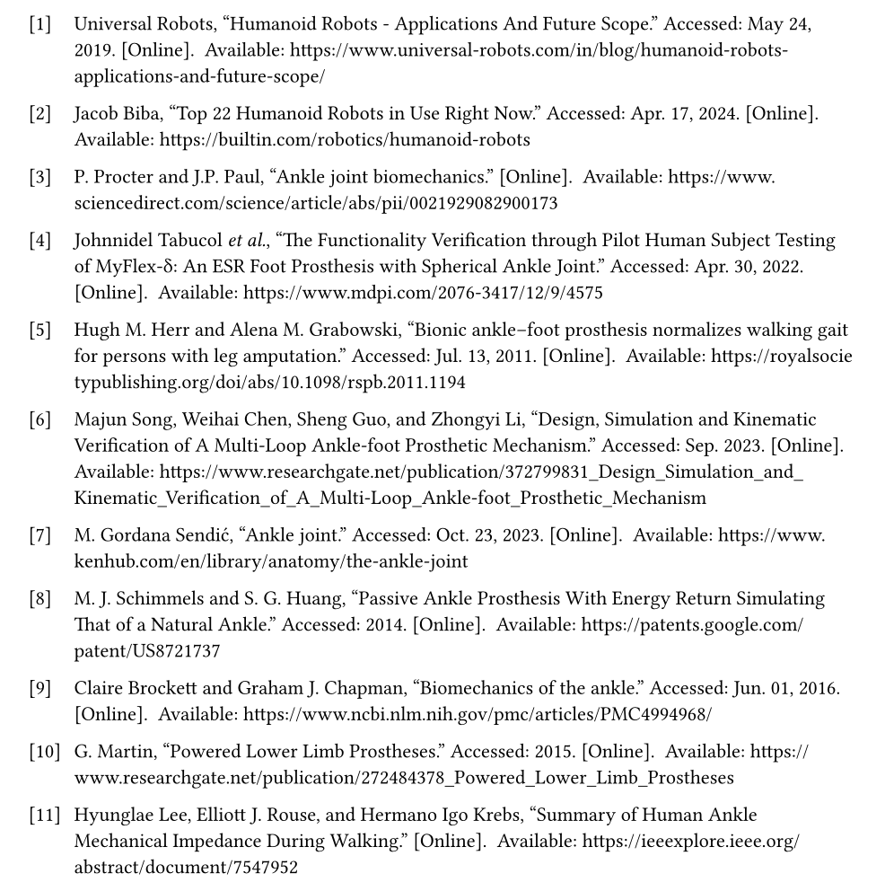
References

Slide 11

Thank You

